Slide 1
Ads Searching System
Team: Monkey-Year-Horse-Month

Slide 2
Outline
Team Introduction
Project Overview
Architecture
Difficulties
Future Improvement
Summary

Slide 3



Team Introduction
Formed in June, 2016
Monkey Year Horse Month
Jialiang Li
Tao Xu
Jingyun Hu

Slide 4
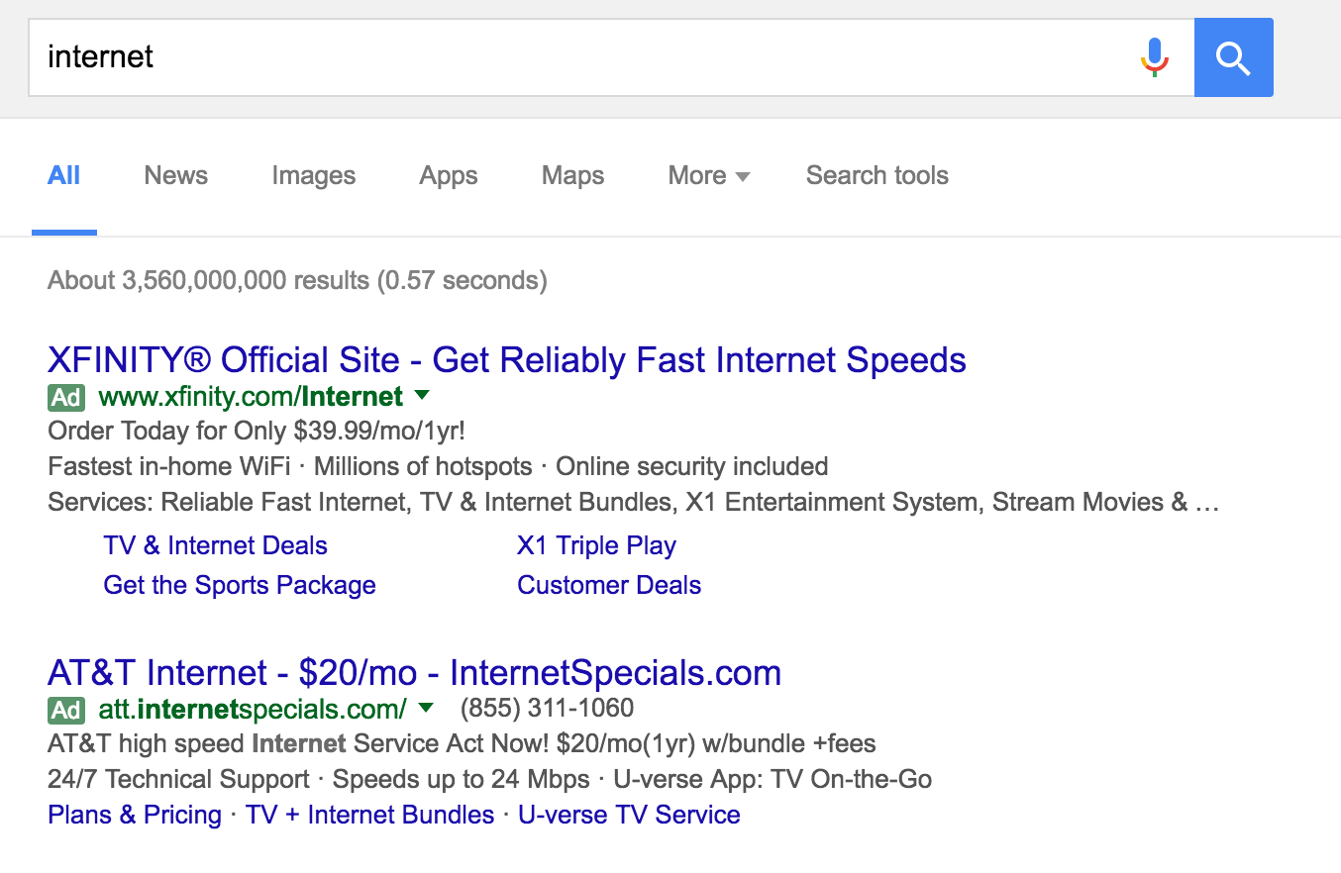
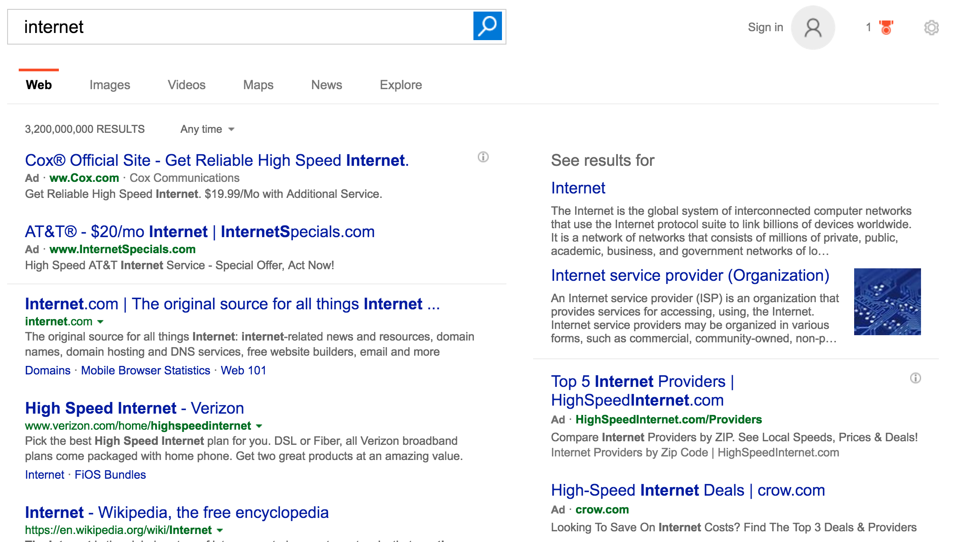
Project Overview

Slide 5
Project Overview
Ads Account
Ads Campaign
Ads
Men
Clothing
Nike
Women
Basketball Shoes
Shoes
Running Shoes

Slide 6
Architecture
Front End
Workflow
Cache
Database
Deployment
Jingyun
Jialiang
Tao

Slide 7
Architecture – Input
Campaign Table
CampaignId | Budget
66 | 500000
67 | 600000
Ad Table
AdId | CampaignId | Keywords | Bid Price | Pclick
1231 | 66 | Nike Running | 1200 | 1.2
1233 | 67 | Basketball | 1400 | 1.1

Slide 8
Architecture – Data Structure
Keyword | AdIds
shoe | 1225, 1231, 1233, 1365
Inverted Index
Forwarded Index
AdId | CampaignId | Keywords | Bid Price | PClick
1231 | 66 | Nike Running | 1200 | 1.2

Slide 9
Architecture – Workflow
Query Understanding
NLP
Select Ads
Ads
Filter Ads
Rank Ads
Quality Score = 0.75 * pClick+ 0.25 * Relevant Score
UI
Select Top K
Pricing
Cost per Click = next Rank Score / current Quality Score + 0.01
Dedupe
Apply Budget
Campaign
Allocate Ads

Slide 10
Difficulties
Memcached

Slide 11
Difficulties
Deployment

Slide 12
Difficulties
Read-Write Lock

Slide 13
Future Improvement
Query Understanding
Distributed System
Machine Learning

Slide 14
Summary
Decompose large problems into smaller ones
Allocate tasks
Disscusion

Slide 15
Thank you
https://ads-searching-system.herokuapp.com/
https://github.com/BitTigerInst/ads-searching-system

